Slide 1
Finding Pharmacy Close To Your Neighborhood
Mohammad Bilal Shafique

Slide 2
Your Possible Destinations:
● New York, NY ● San Francisco, CA ● Jersey City, NJ ● Boston, MA ● Chicago, IL

Slide 3
Let’s Take a Look at Their Maps

Slide 4
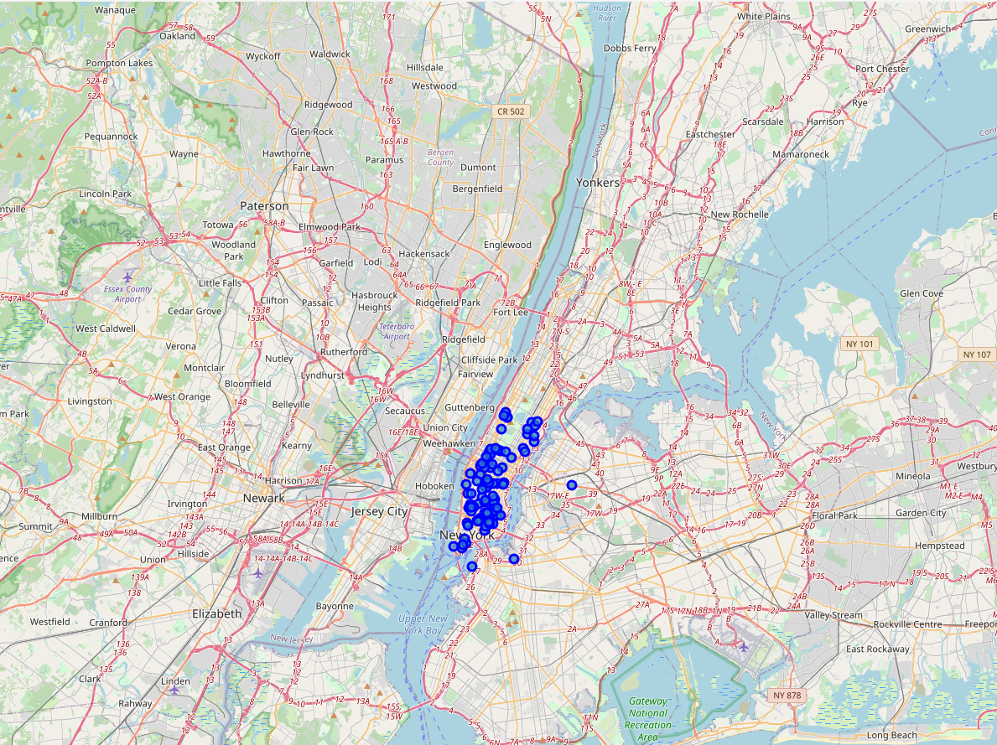
New York

Slide 5
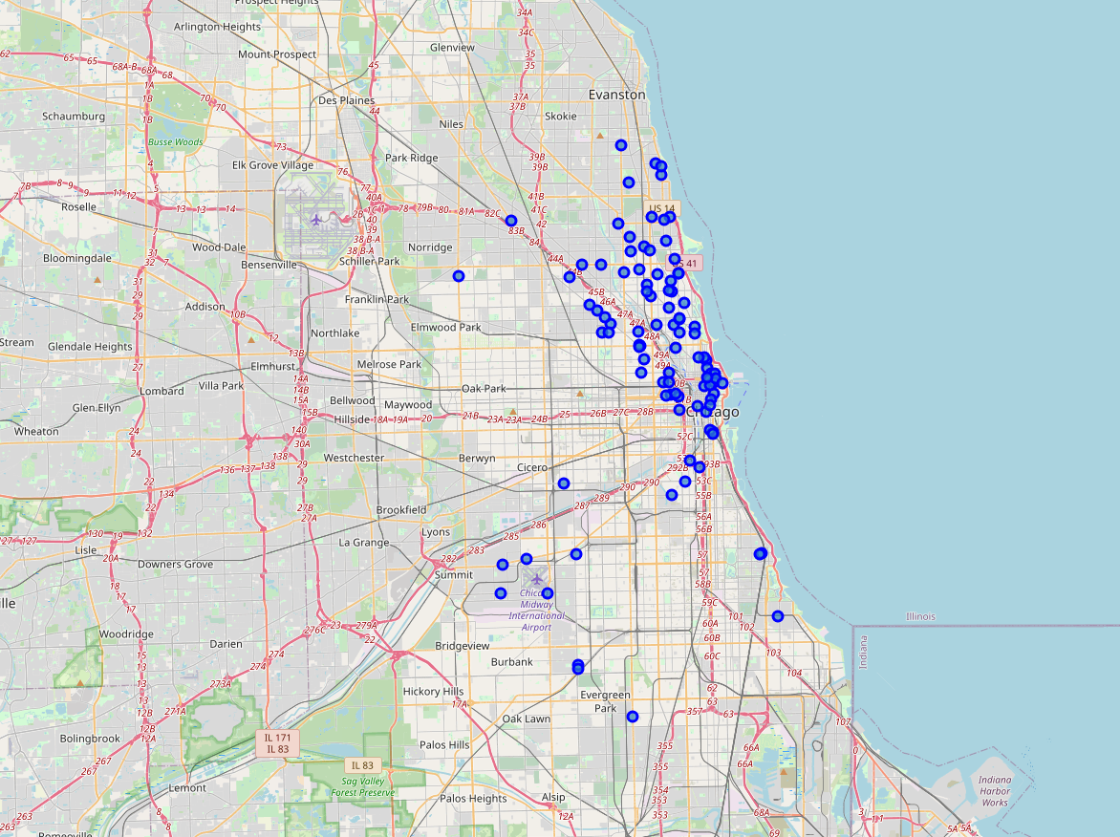
Chicago

Slide 6
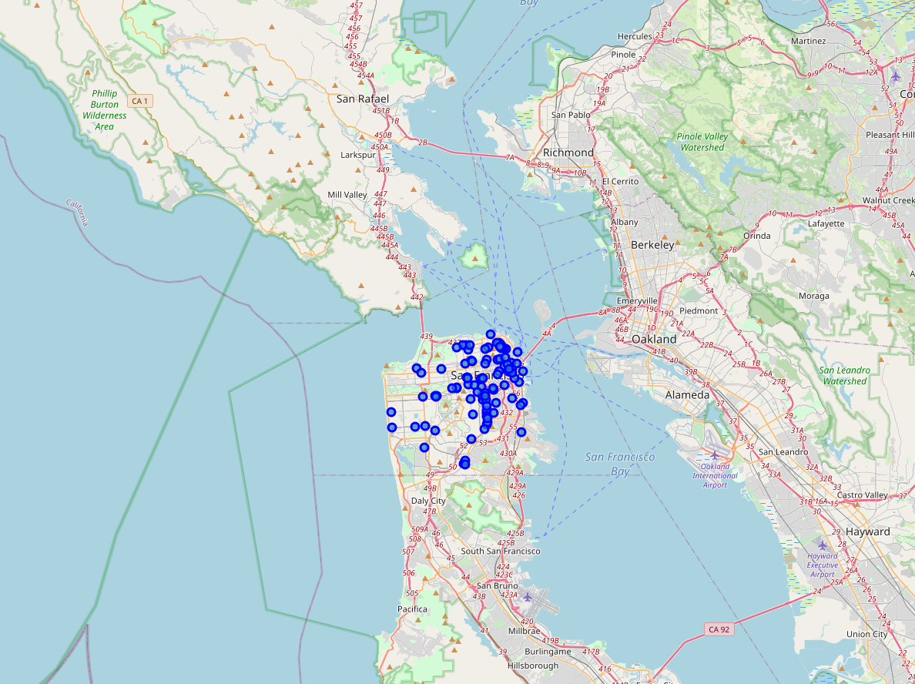
San Francisco

Slide 7
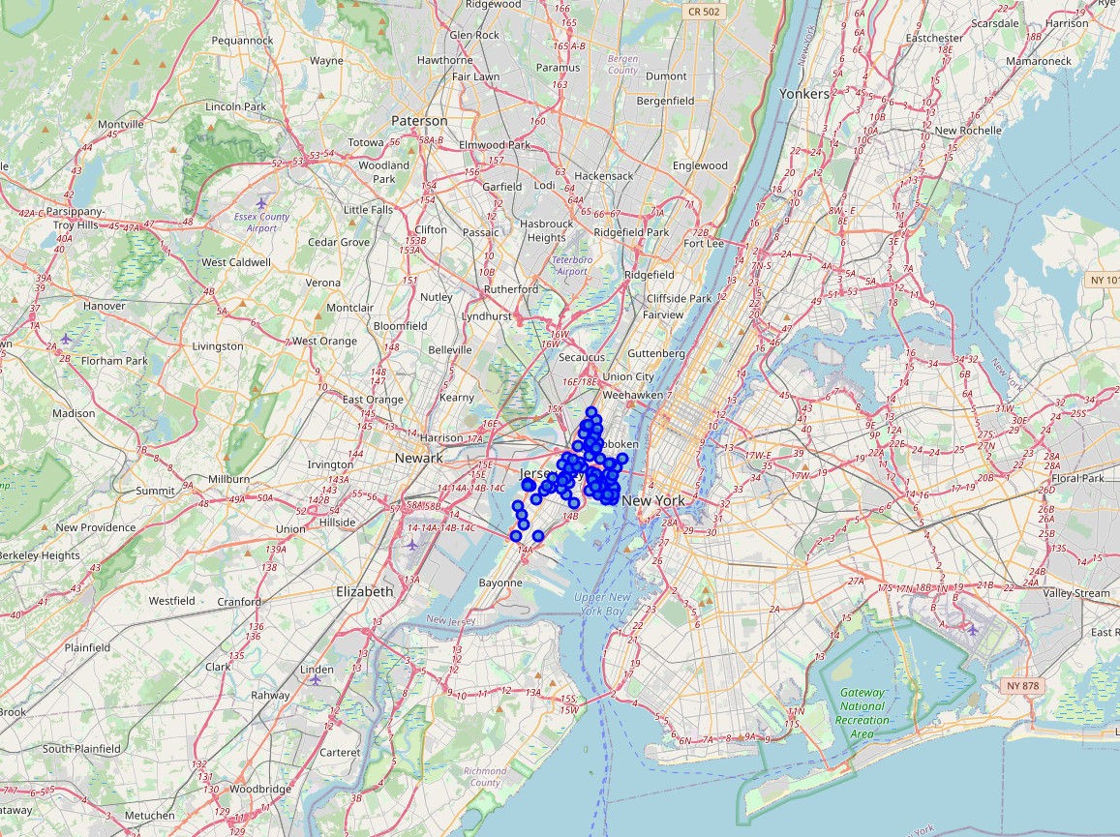
New Jersey

Slide 8
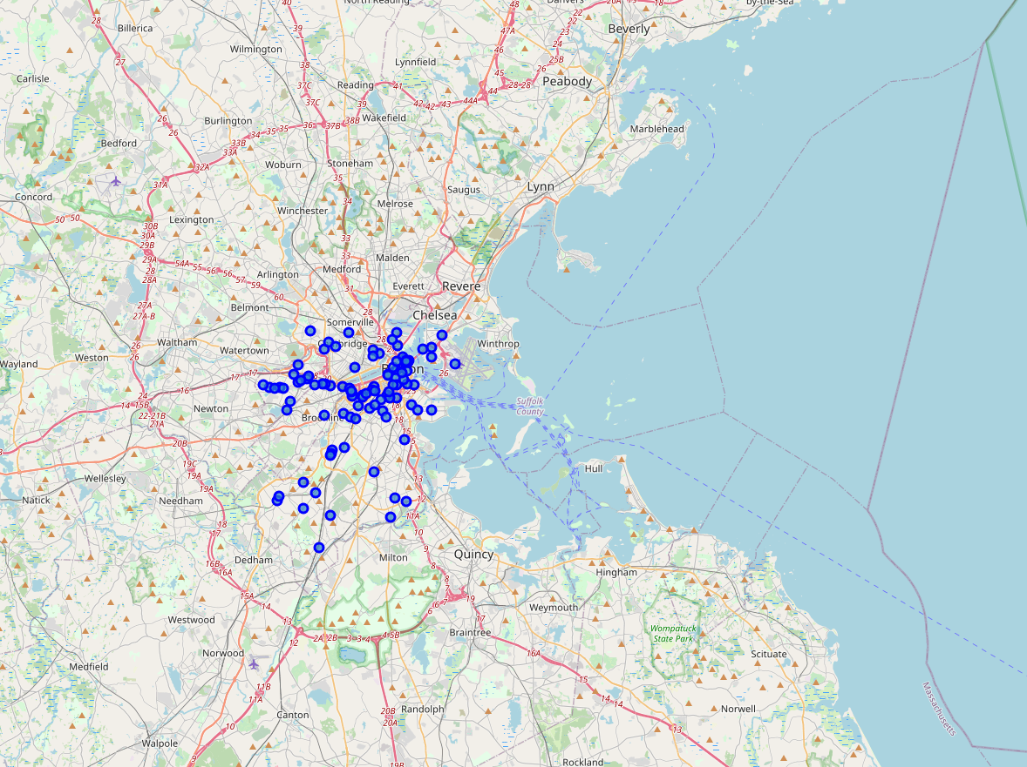
Boston

Slide 9
How did I decide?
Calculated the centre of all the pharmacies (That huge green circle)
Then calculated the distance from each pharmacies to the centre
Then ranked the cities according to the lowest distances

Slide 10

New York MDMC

Slide 11
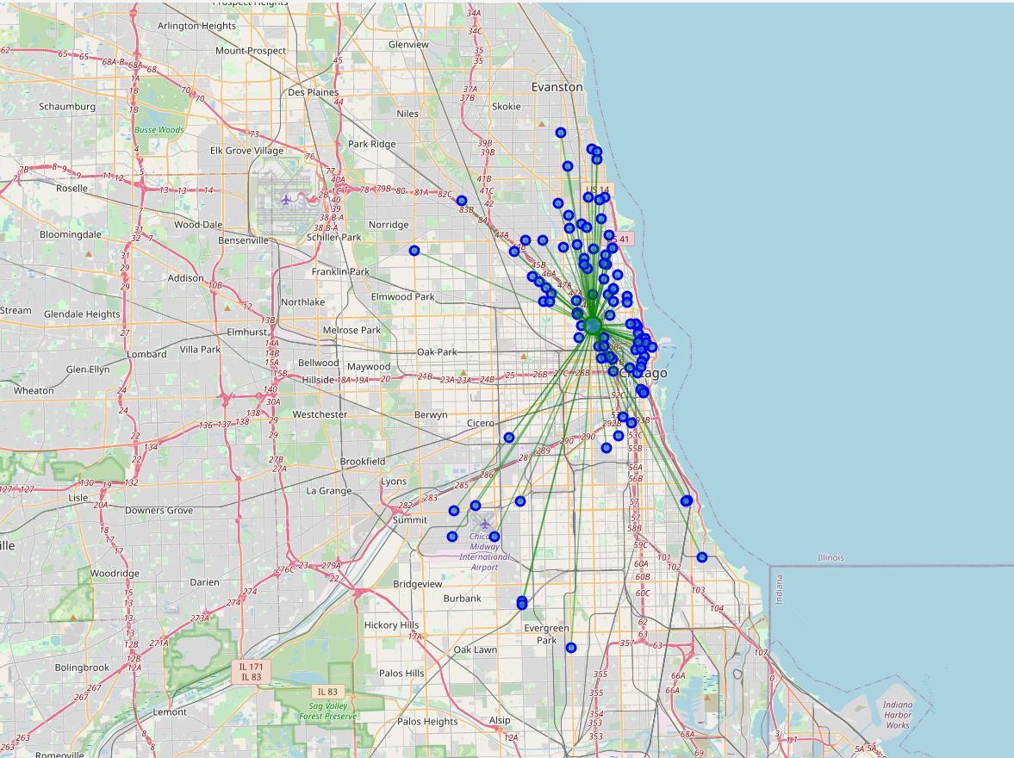
Chicago MDMC

Slide 12
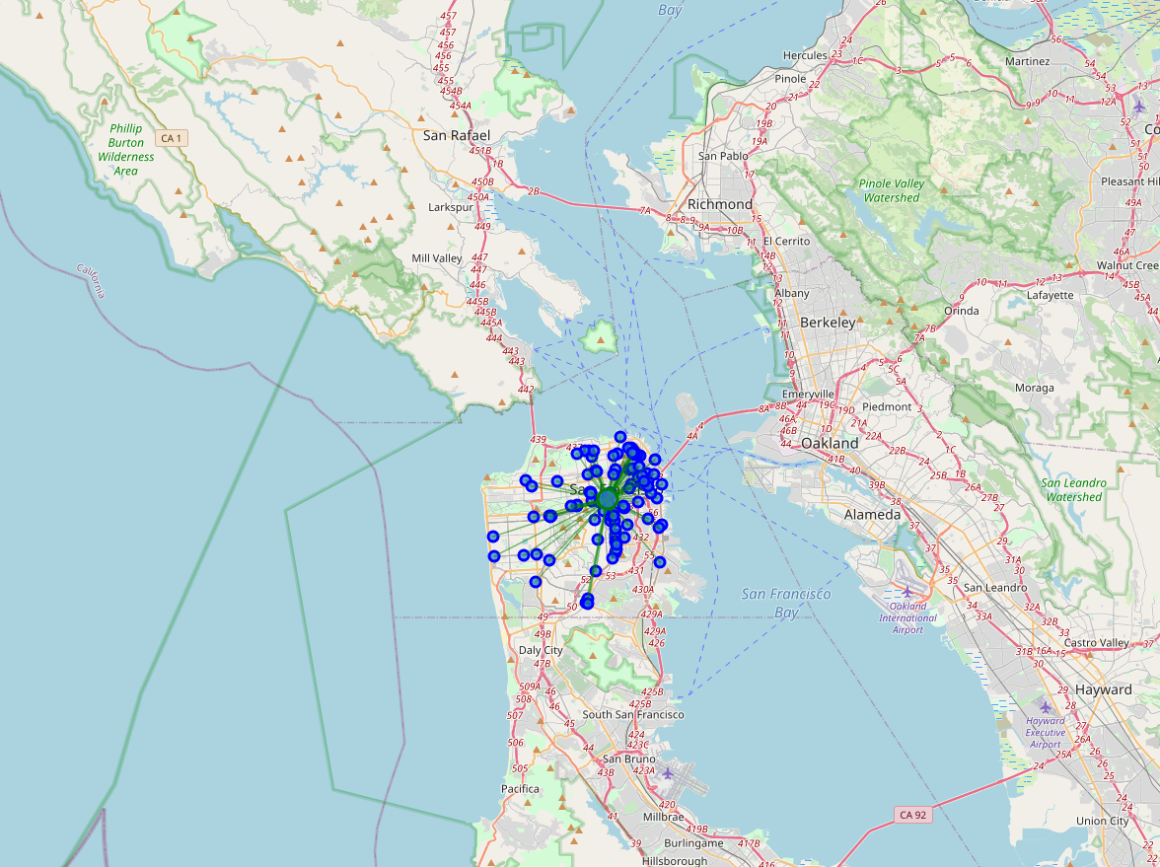
San Francisco MDMC

Slide 13
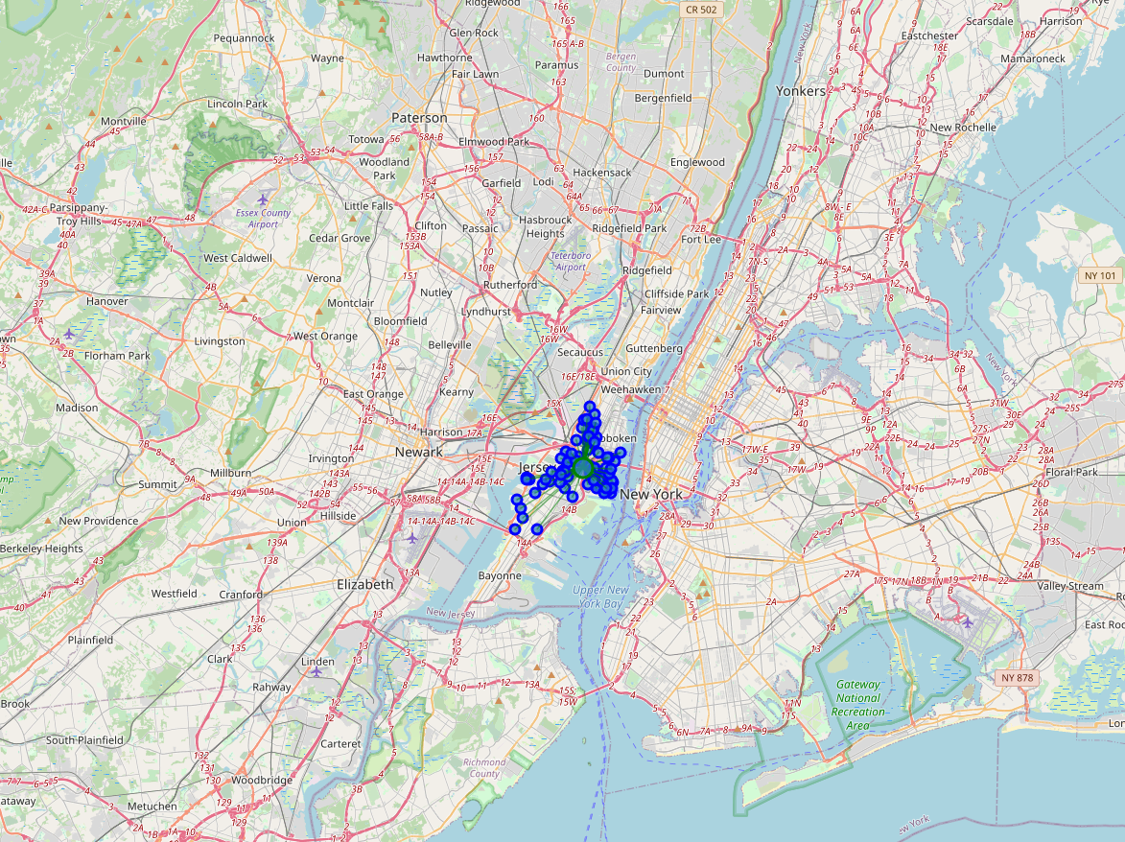
New jersey MDMC

Slide 14
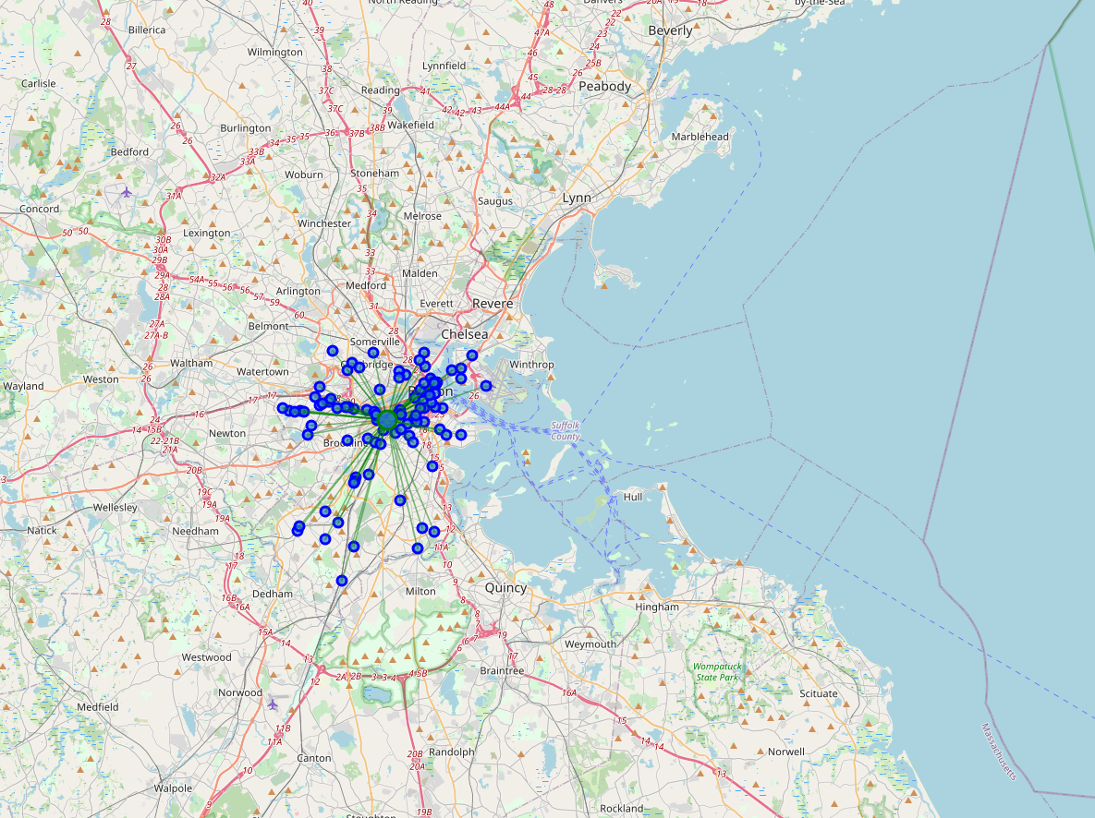
Boston MDMC

Slide 15
Results:
Jersey City
New York
San Francisco
Boston
Chicago

